Slide 1
Image Tracking Tendon Fibers Project
Team Name: River Rats
Team Members: Andrew Araujo, Aneesha Shrestha, Ian McCall, Adi Gurevich

Slide 2
Project Problem
Currently tendons cannot be x-rayed and are difficult to visualize. To expand medical research, we are creating software that can take CT-scans of tendons and recreate 3D models so scientists can understand what they look like, and how they interact with surrounding tissue.

Slide 3
Current Agenda & Progress
We’re working on training our yoloV8 AI model to recognize and select fibers automatically, then using the tracked tendons to create 3D recreations.
At this point, we’ve been able to track a fiber that’s been manually selected and created a preprocessing pipeline for our images.

Slide 4
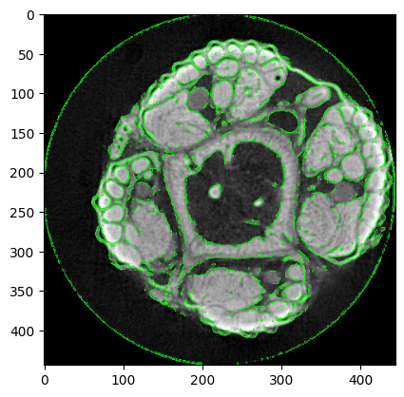

Slide 5
Attempted New Strategies: Black and White Contrast Filter OpenCV Contour Image YOLOv8 Bounding Box Detection Schedule

Slide 6
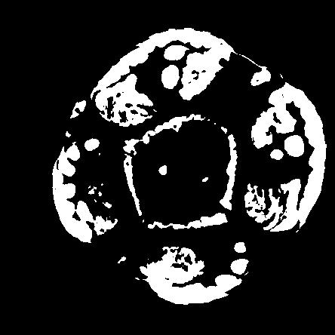
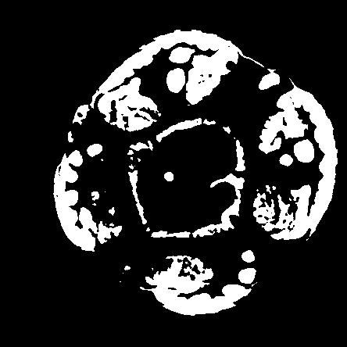

Slide 7
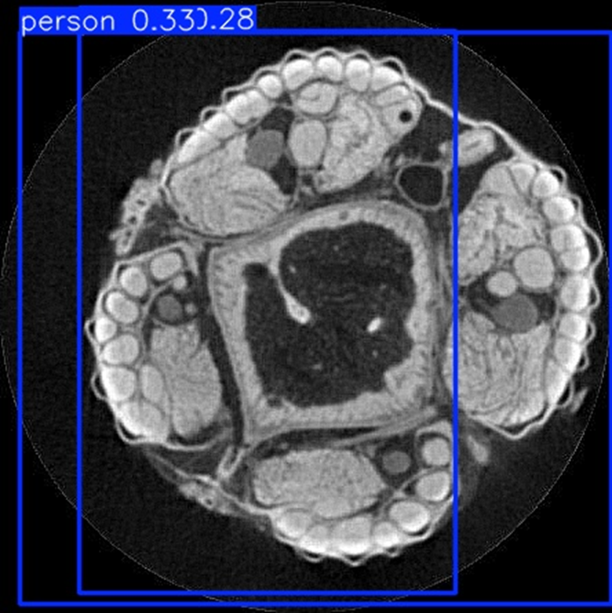
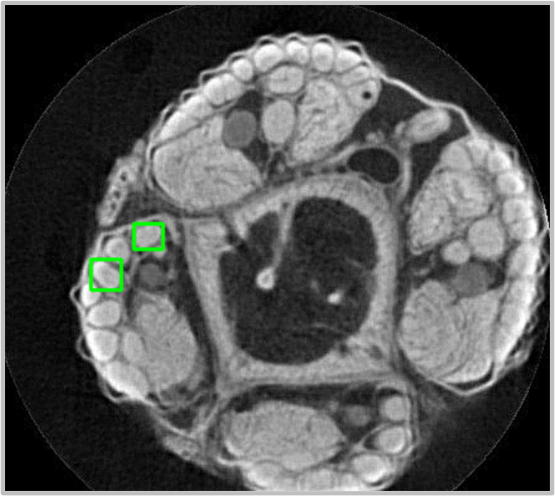

Slide 8
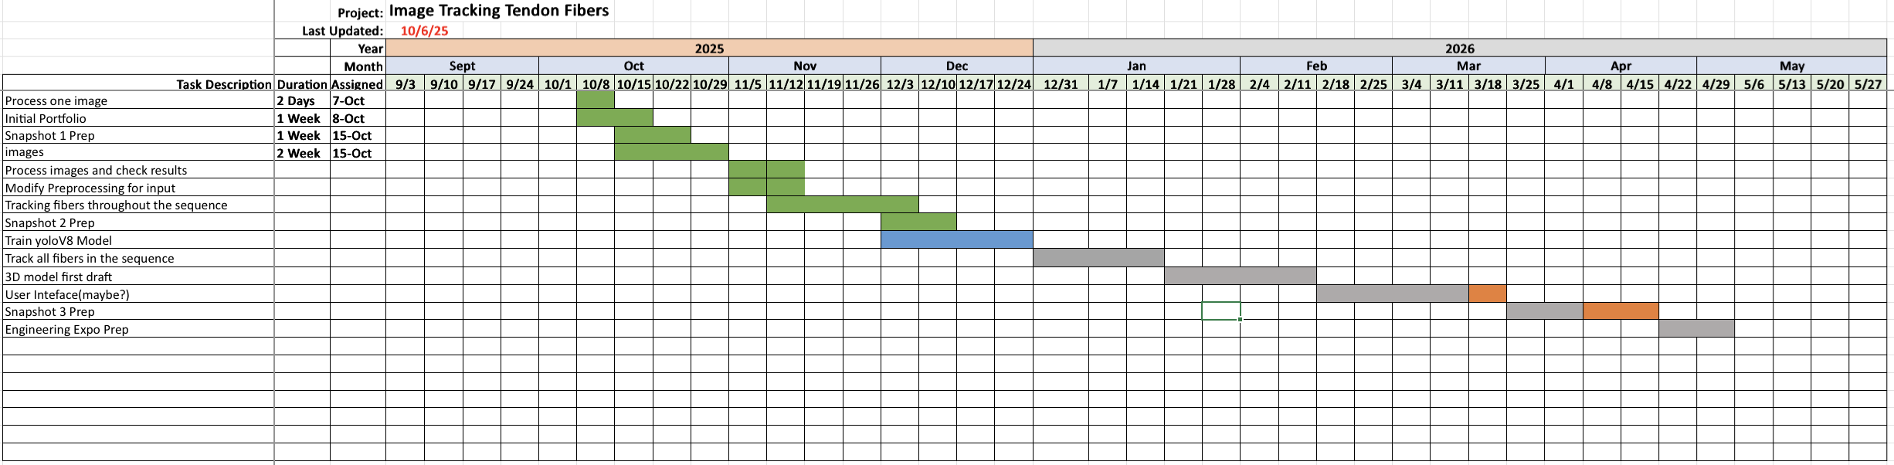

Slide 10
Semester 2 Plan
We plan on training the YOLOv8 model with the hand tracked fiber images we are developing to then allow us to track all fibers through any given series of images. Once all fibers within the series can be tracked, we will use that data to construct a 3D model of fibers. Once we have a rudimentary 3D model, we can then develop some fine tuning that will allow the user to customize the model selecting which fibers to visualize and which to leave out.

